Slide 1
Fun with solar
Github: https://github.com/tobyvessalius/nasaopendataProject
Trello: https://trello.com/b/0PP00J8r/ec601-nasa-project
Xinran Zhang zhangxr@bu.edu
Jiahao Chen tobychen@bu.edu
Heming Huang hemingh@bu.edu
Siyue Wang siyuew@bu.edu
Notes:
1
Hi everyone, my name is Siyue Wang. And they are my teammates, Jiahao Chen, Xinran Zhang, Heming Huang. Our team name is Fun with NASA.
Let’s first have a basic review of our project. Our project is using NASA open data and data provided by NREL which is National Renewable Energy Laboratory. And by analyze those data, we provide our evaluation for our users whether a place is suitable for building solar power plants or not.

Slide 2



Web Application Aiming to:
*
https://www.solarcostguide.com/guides/wp-content/uploads/2015/06/Solar-Panel-Installer-1024x682.jpg
http://bramptondentalarts.com/wp-content/uploads/2013/08/FAMILY1.jpg
http://blog.hackerrank.com/wp-content/uploads/2015/10/government.jpg
2

Slide 3
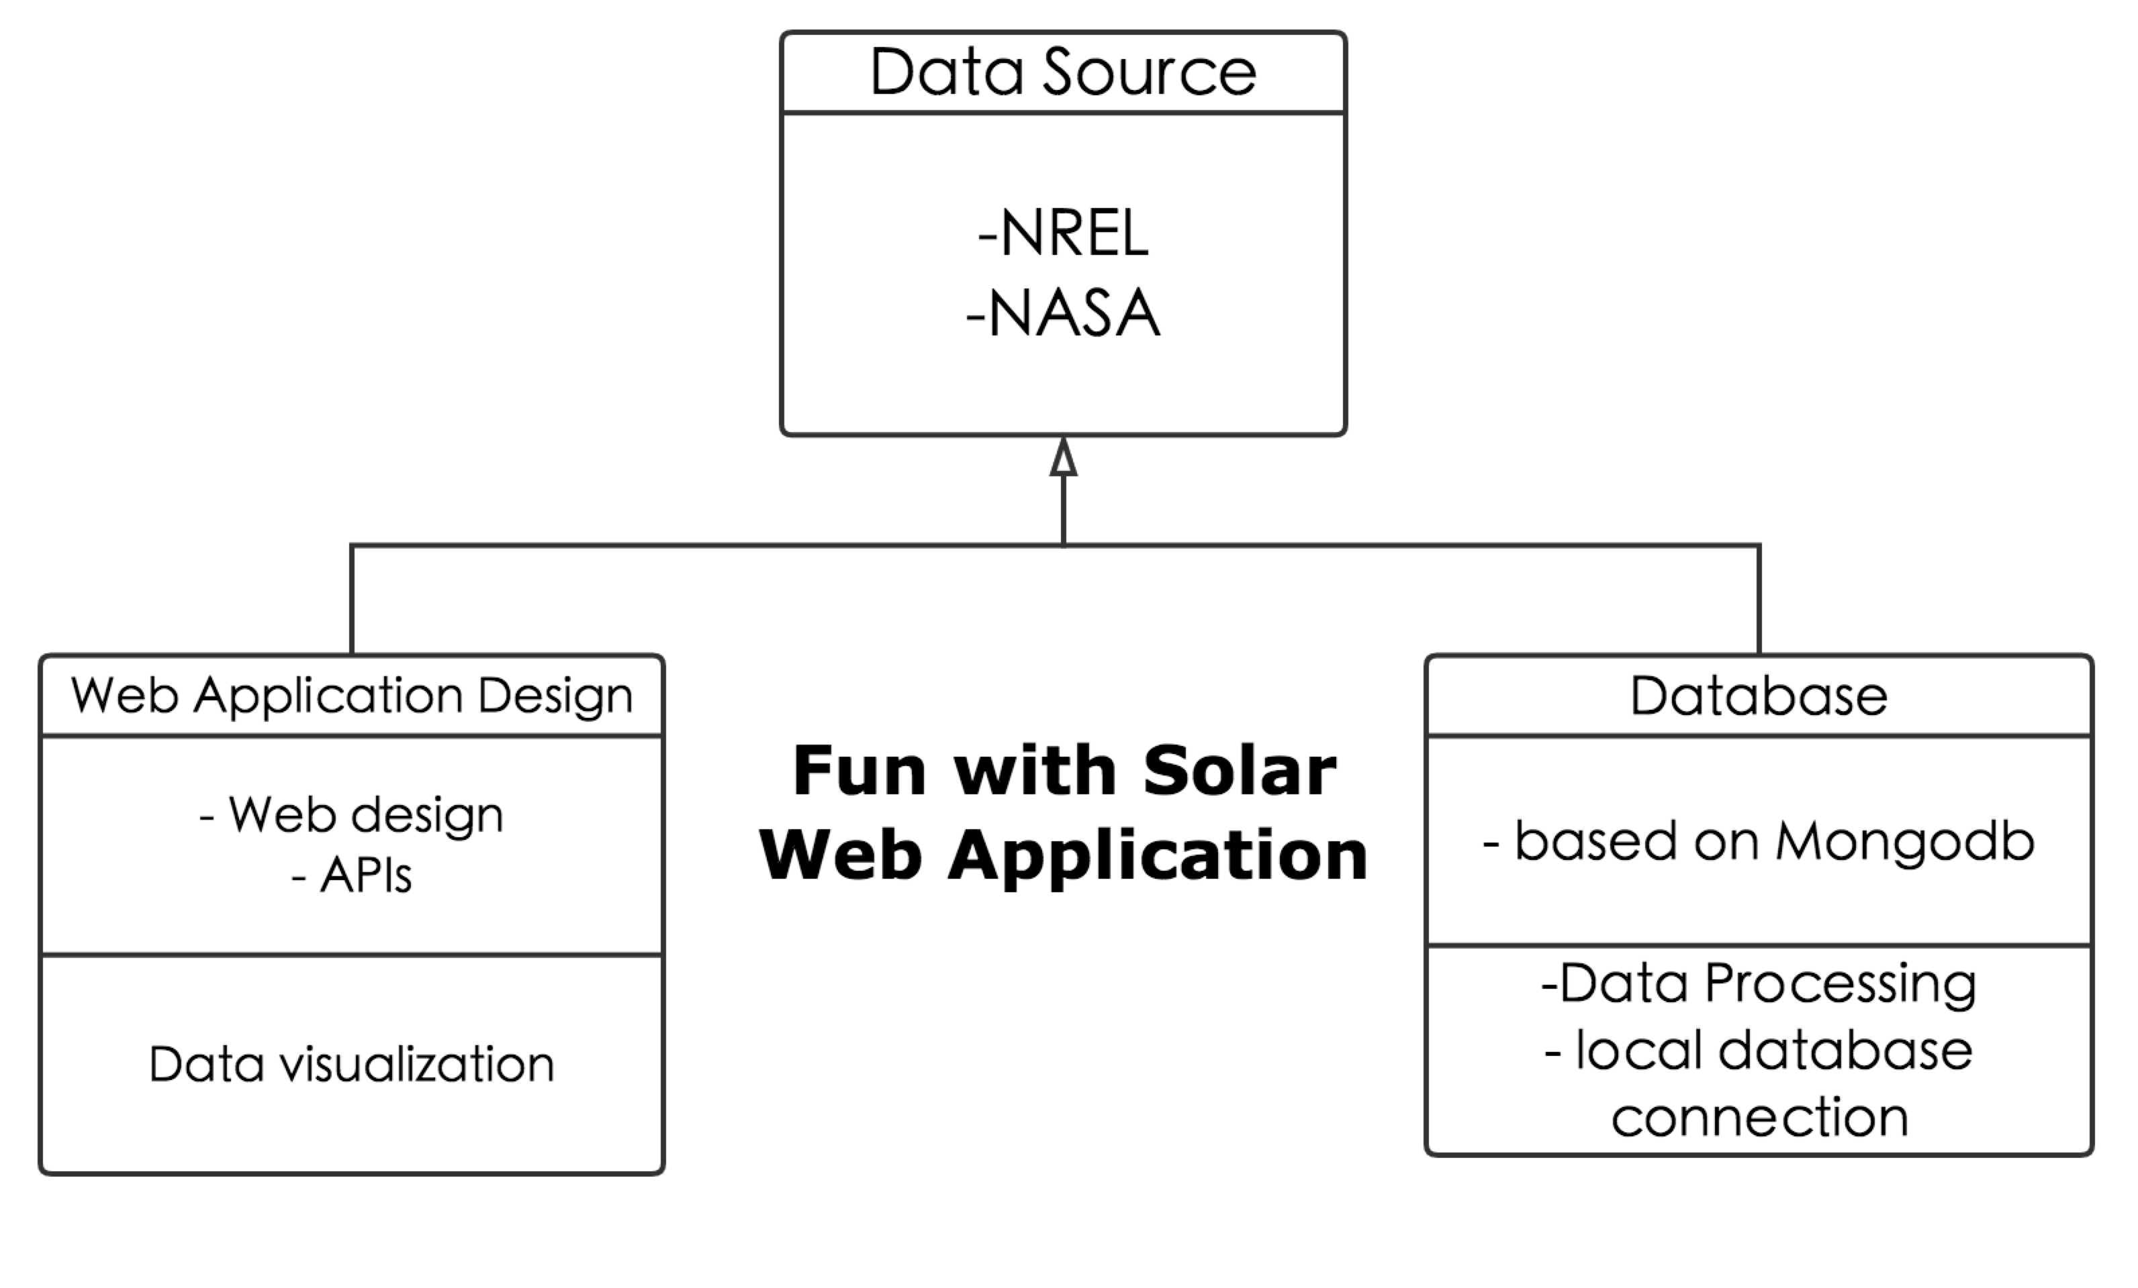
Project Structure
*
3

Slide 4
Application System Diagram
*
NREL
Open Data
NASA
Data Analyses
Database
MongoDB
Evaluation System
Visualization
JavaScript
HTML
Web Application
CSS
4

Slide 5
Product Highlights
*
Original Data from NREL and NASA
Data Screening by scripts
Website and User Interface Design based on Bootstrap
Mongodb database managed data
Build up web user interface
Connect our local database with Visualization tools
Connect our website to AWS cloud service
Write two original scripts.
5

Slide 6
DEMO
*
6

Slide 7
Test
*
Via Monkey test
Browser compatibility
Scroll bar function
Mouse function
Click-on function
Media Play function
Jump function
Database Authentication…..
Defect Detected
•Media Play Function:
Users click on the A12:H32, and video should be played and when users click the 'x' on the up right side, it should be closed.
7

Slide 8
Project Summary
*
Things that worked well
Switch the direction and go back to the right track
Self-learning
Communication
8

Slide 9
Project Summary
*
Things that did not go well…
Data loss!
Manage online database
Web Test
9

Slide 10
Perspective Optimization
*
Put the database online and update it more often on cloud using web service.
Build up models to create systematic plans for consumers.
Using multiple APIs to embedded the cost evaluation
Evaluation parts can be improved……
10

Slide 11
Reference links
*
NREL: http://www.nrel.gov/renewable_resources/
NASA: http://www.earthobservatory.nasa.gov/Features/SORCE/
Mongodb Tutorial: https://docs.mongodb.com/v3.2/tutorial/
APIs:
https://developers.google.com/maps/documentation/javascript https://developers.google.com/maps/documentation/streetview/ https://onlinehelp.tableau.com/current/api/js_api/en-us/JavaScriptAPI/js_api.htm
Tableau Tutorial:
http://www.tableau.com/learn/tutorials/on-demand/getting-started
11

Slide 12
THANK YOU
*
12

